Slide 1

Mobile Learning Application Development
Presented By:
Rakib Hossen
Assistant Professor
Dept. of Cyber Security Engineering (CySE), UFTB

Slide 2

Flutter – Tabs
Tabs are exactly what you think it is. It’s part of the UI that navigates the user through different routes(ie, pages) when clicked upon. The use of tabs in applications is standard practice. Flutter provides a simple way to create tab layouts using the material library. In this article, exploring we will be exploring the same in detail.
Process:
Design a TabController.
Add tabs to the app.
Add content in each tab.

Slide 3
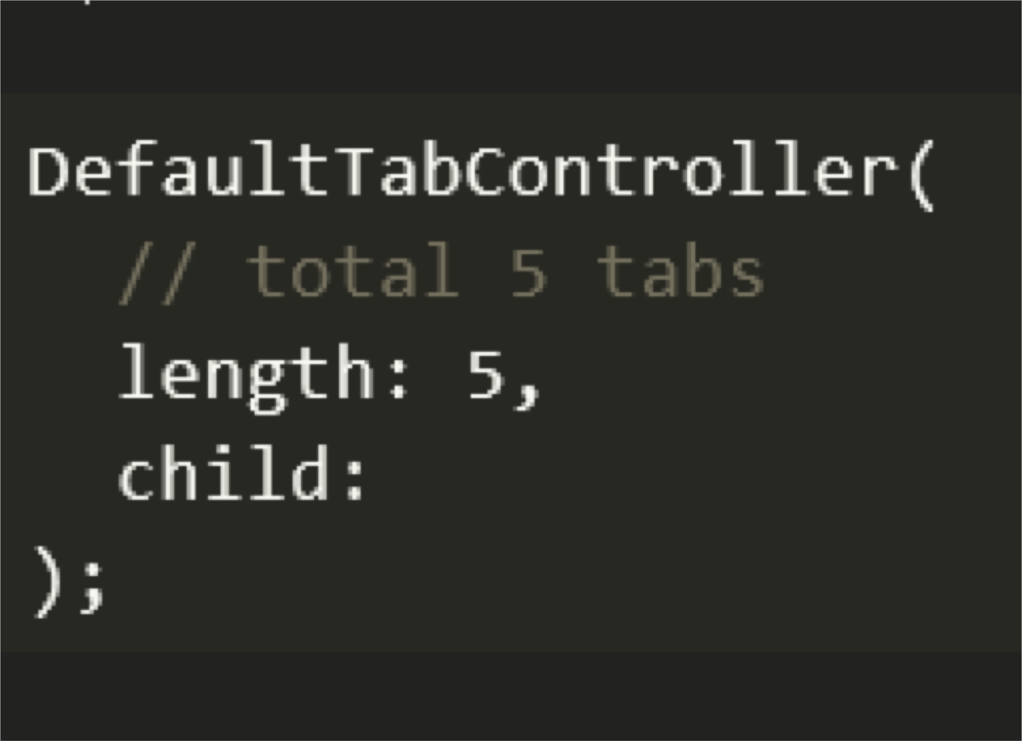
Designing a Tab Controller:
The TabController as the name suggests controls the functioning of each tab by syncing the tabs and the contents with each other. The DefaultTabController widget is one of the simplest ways to create tabs in flutter. It is done as shown below:

Slide 4
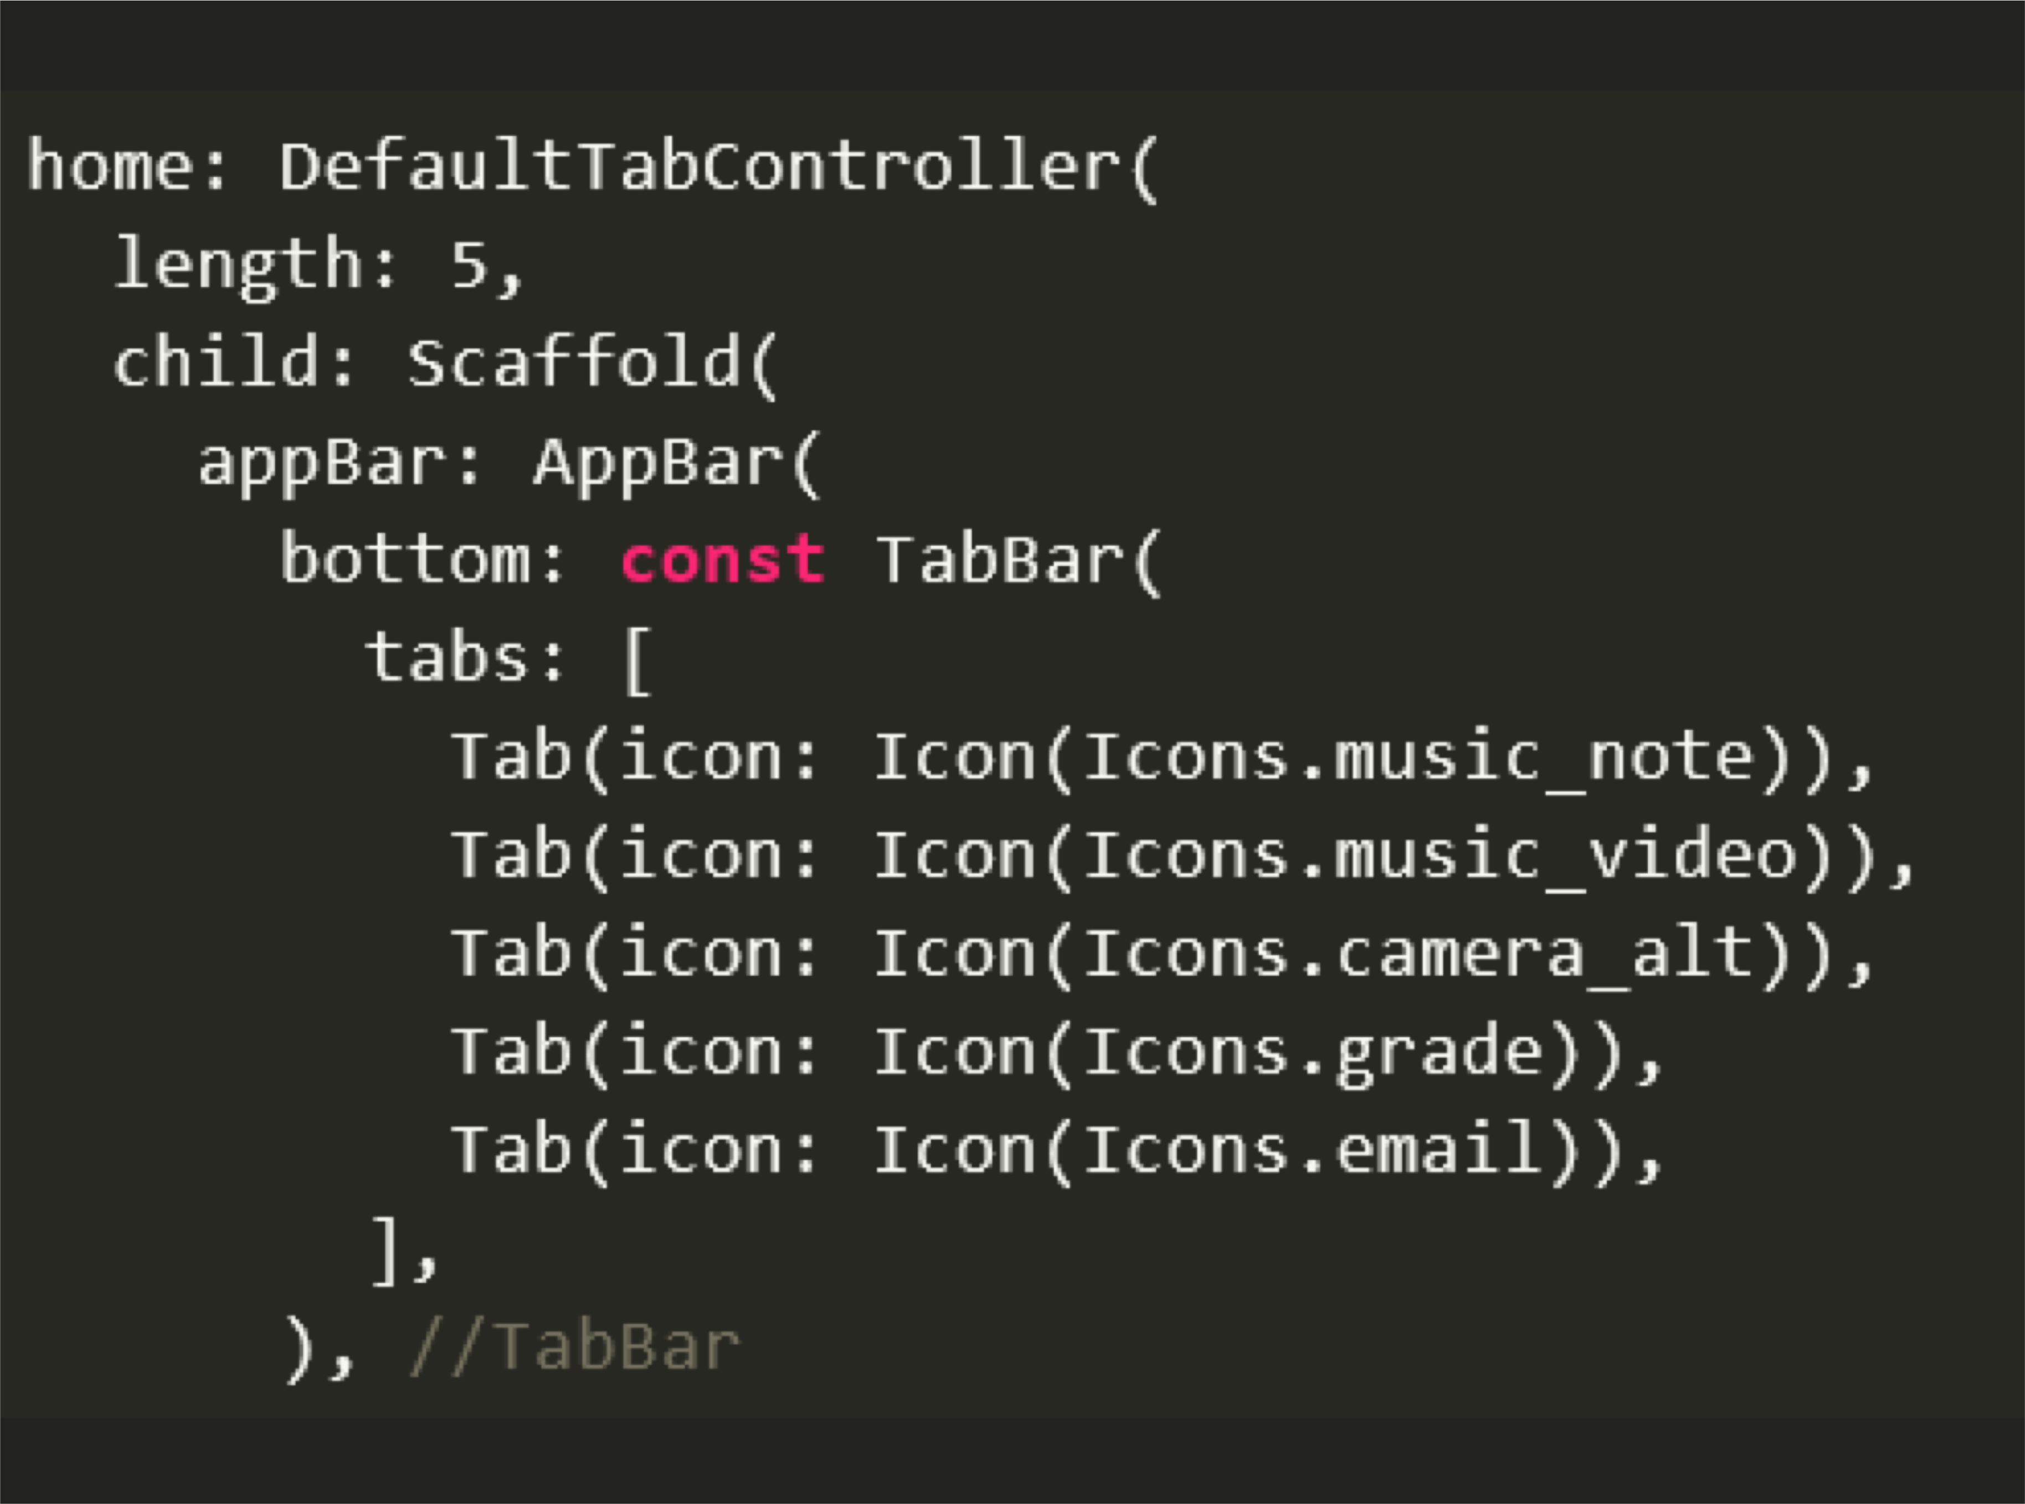
Adding tabs:

Slide 5
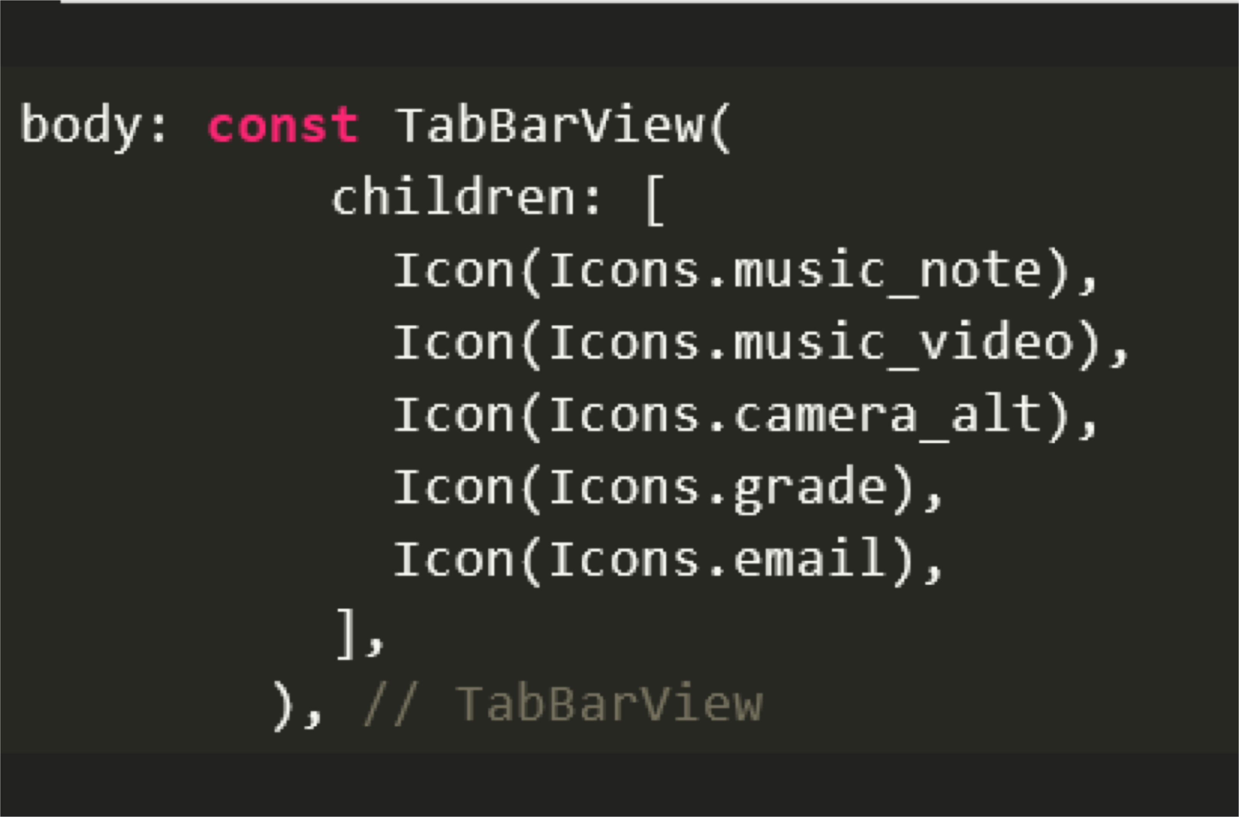
Adding content to tabs:
The Tab BarView widget can be used to specify the contents of each tab.

Slide 6
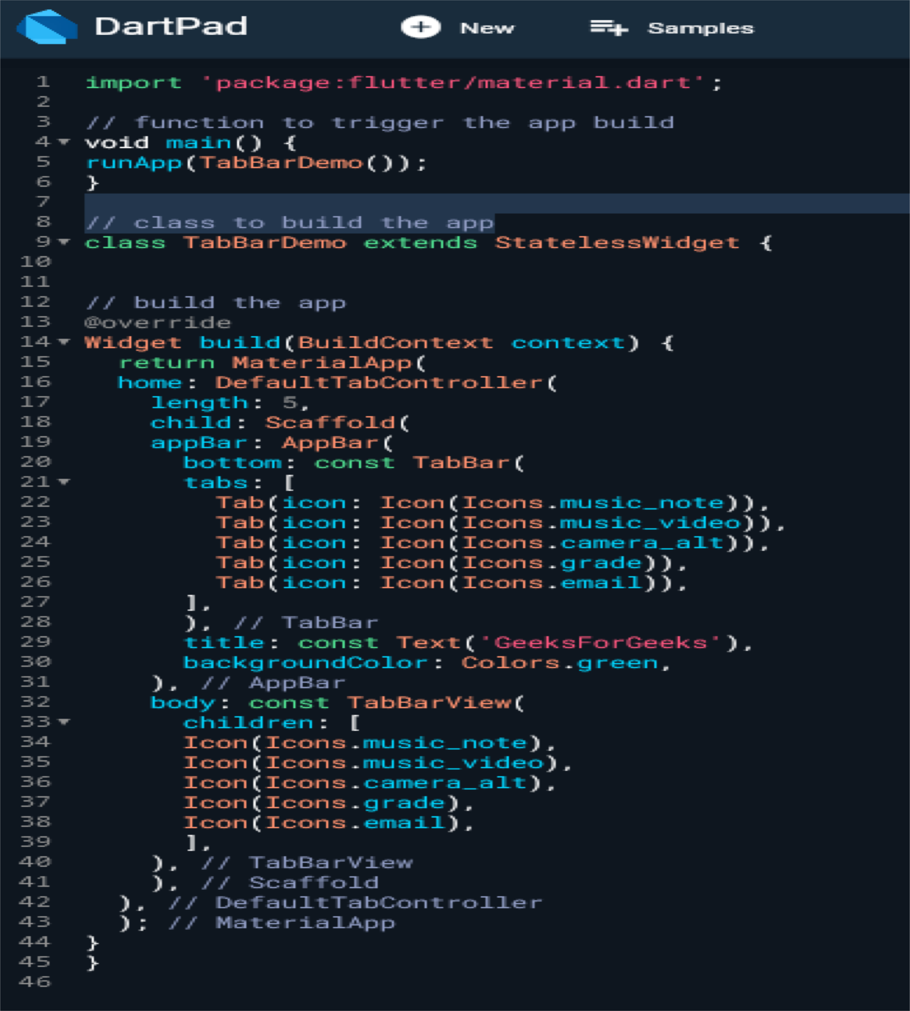
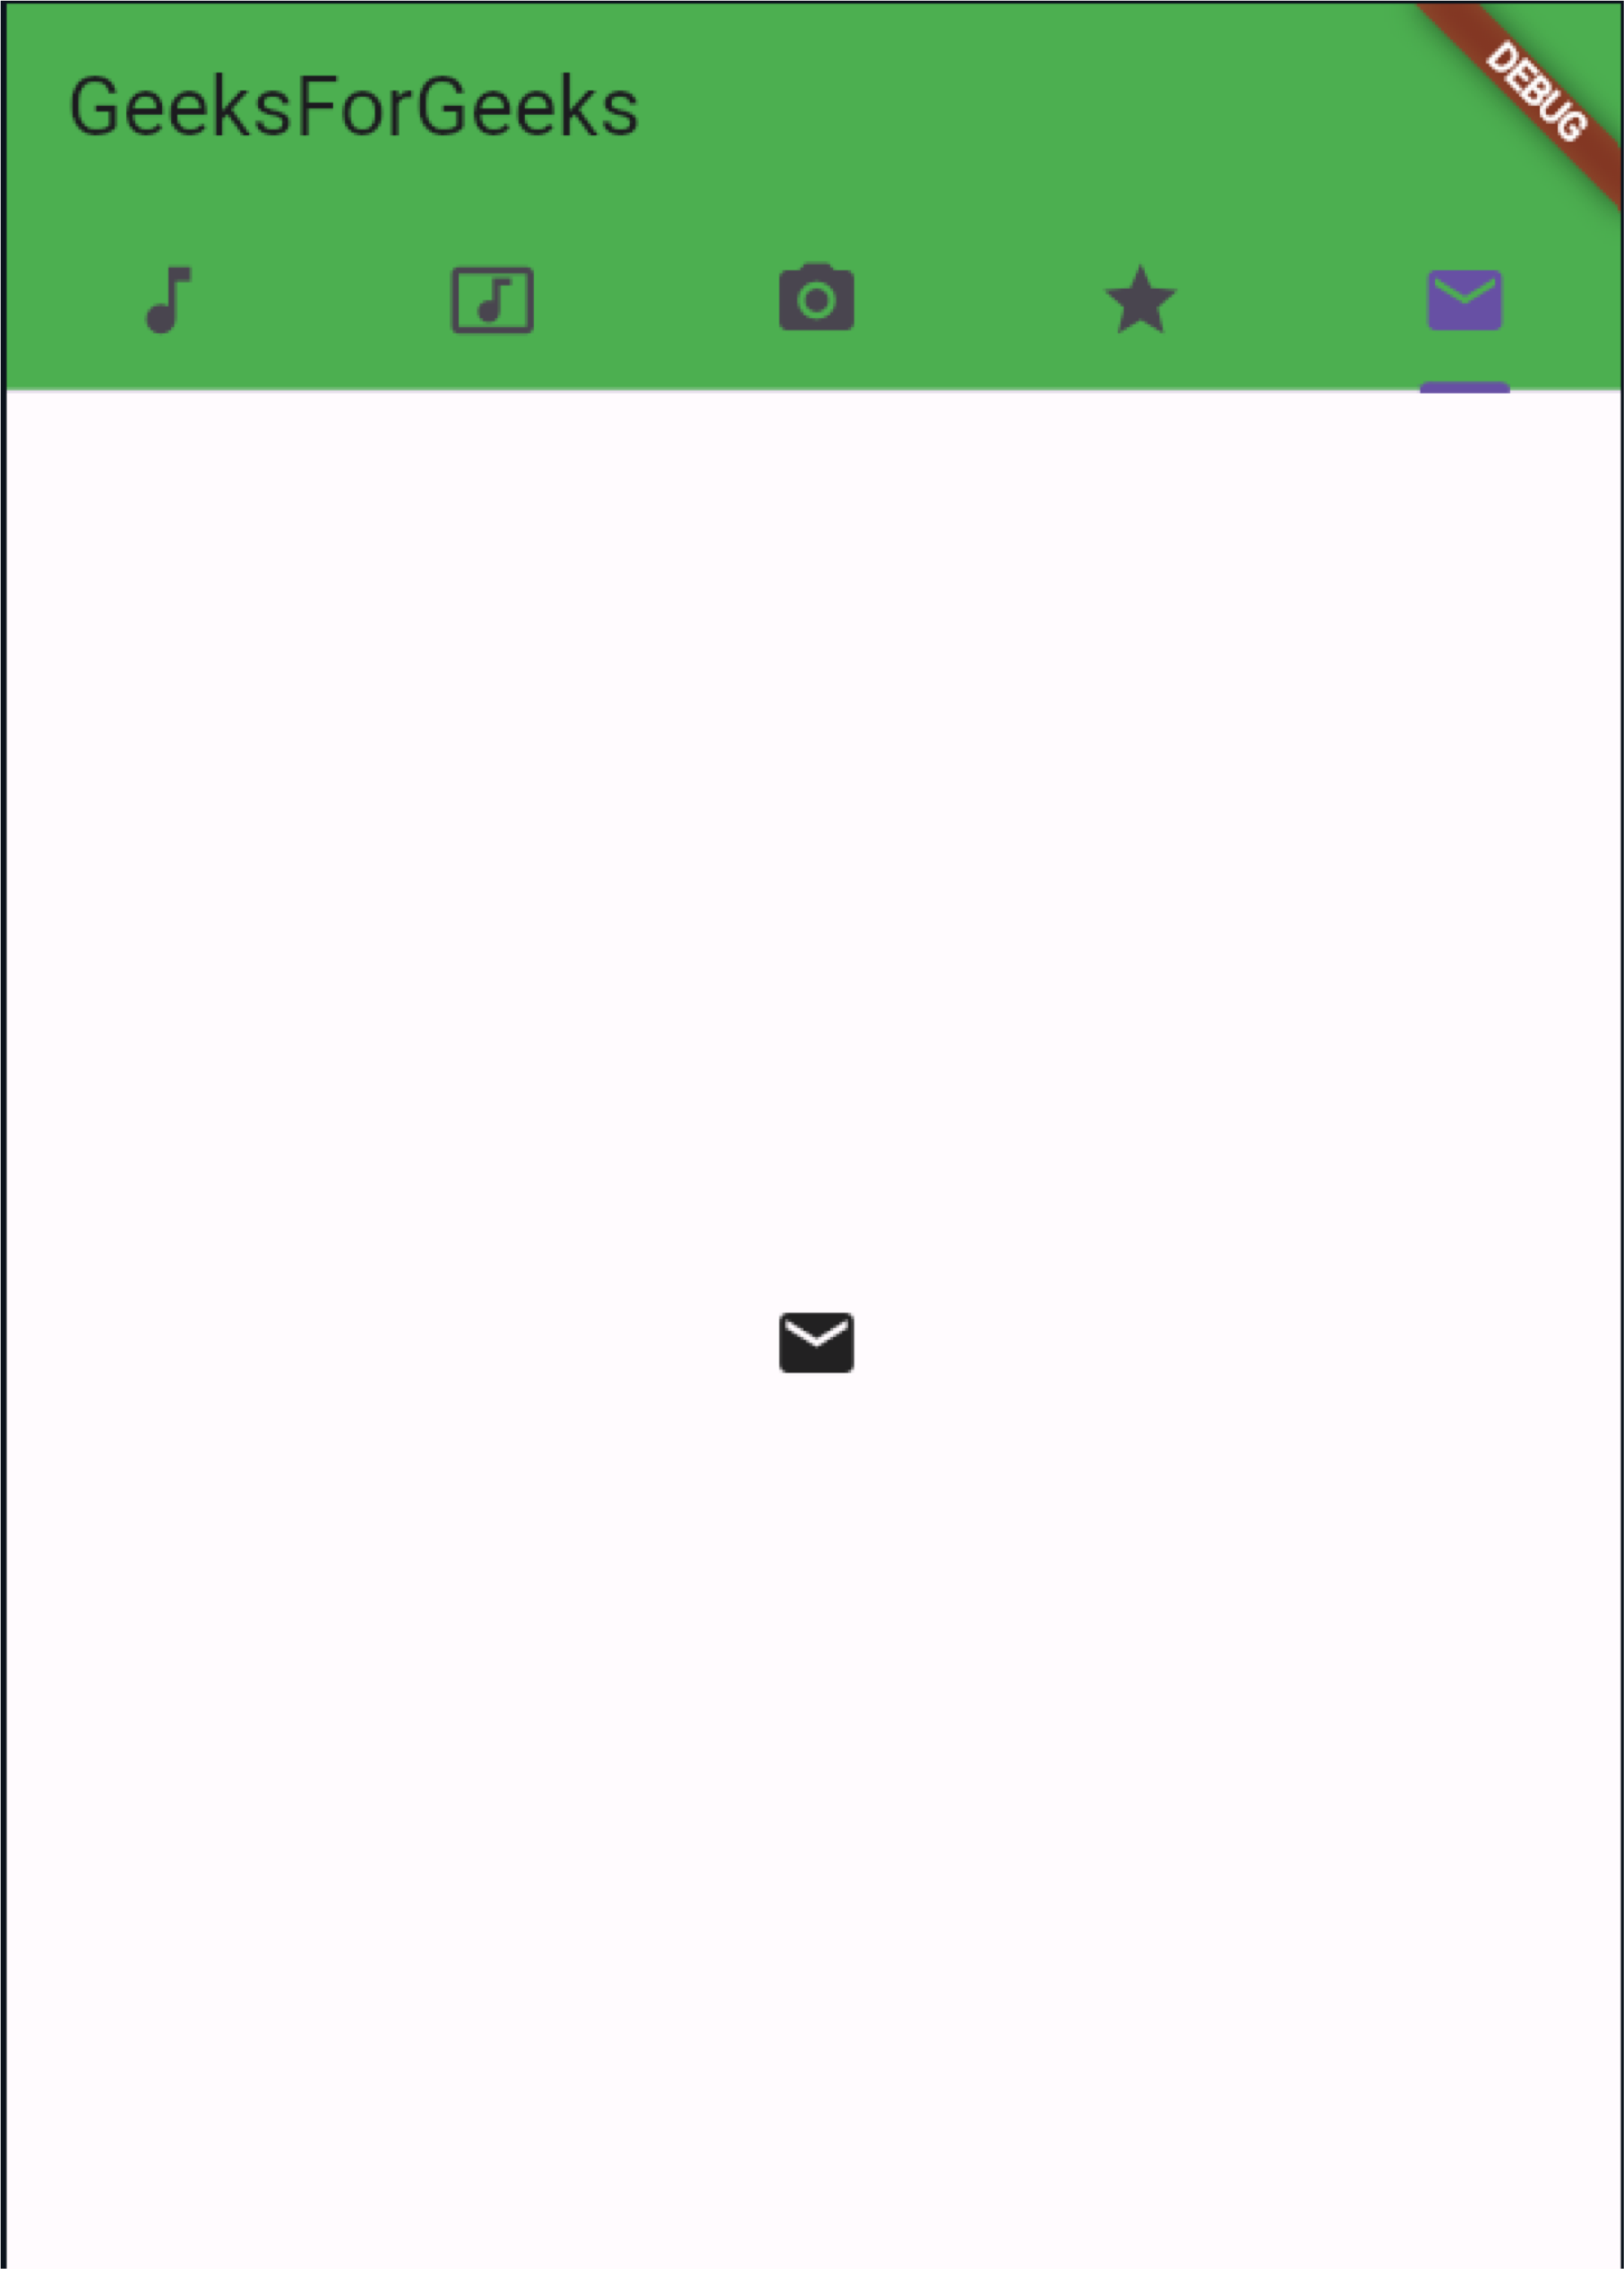

Slide 7
Icon Class in Flutter

Slide 8
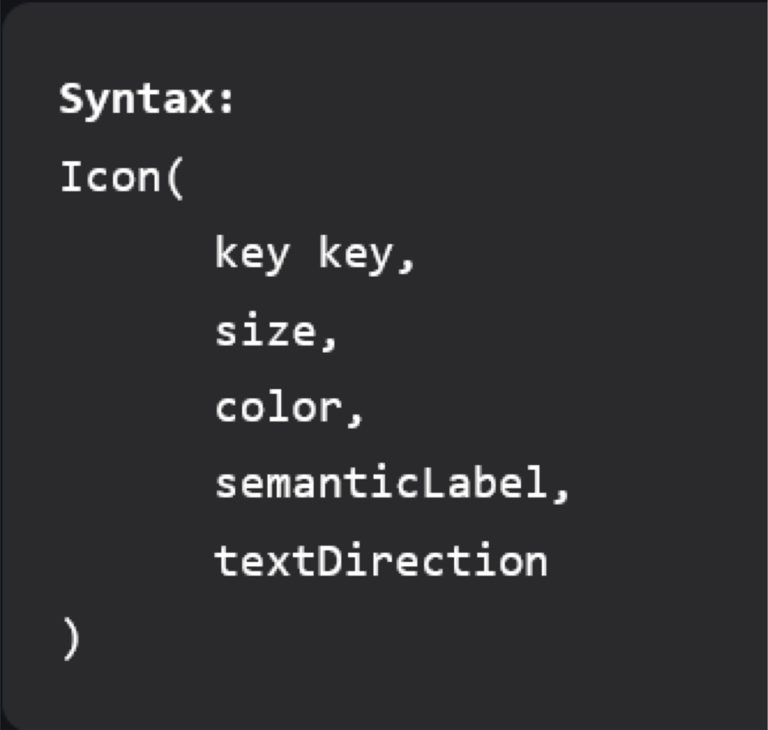
Icon Class in Flutter
Icon class in Flutter is used to show specific icons in our app. Instead of creating an image for our icon, we can simply use the Icon class for inserting an icon in our app. For using this class, you must ensure that you have set uses-material-design: true in the pubsec.yml file of your object.
Properties:
color: It is used to set the color of the icon
size: It is used to resize the Icon
semanticLable: It comes in play while using the app in accessibility mode (i.e., voice-over)
textDirection: It is used for rendering Icon

Slide 9
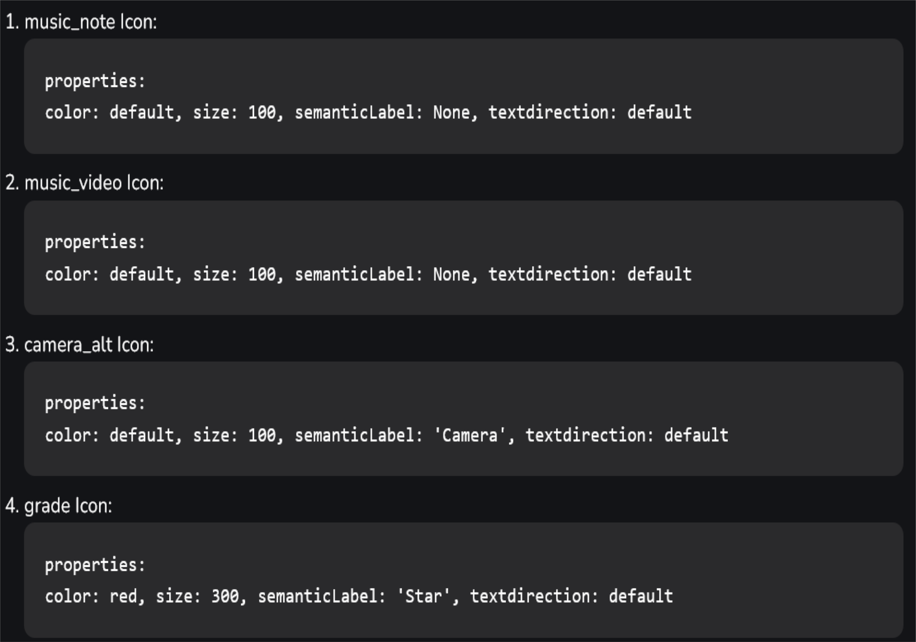
Icon Class in Flutter

Slide 10
Expanded Class in Flutter

Slide 11
Expanded Class in Flutter
When we create any child of a row or column, we provide the size of the widget according to the screen size but sometimes when we provide more size of child as compared to screen size we get a warning, and our widget goes out of the screen for resolving this we put a child of a row or column in an expanded widget so that the child occupies only the available space along the main axis. When we create multiple children then the available space between the children will divide according to the flex factor.

Slide 12
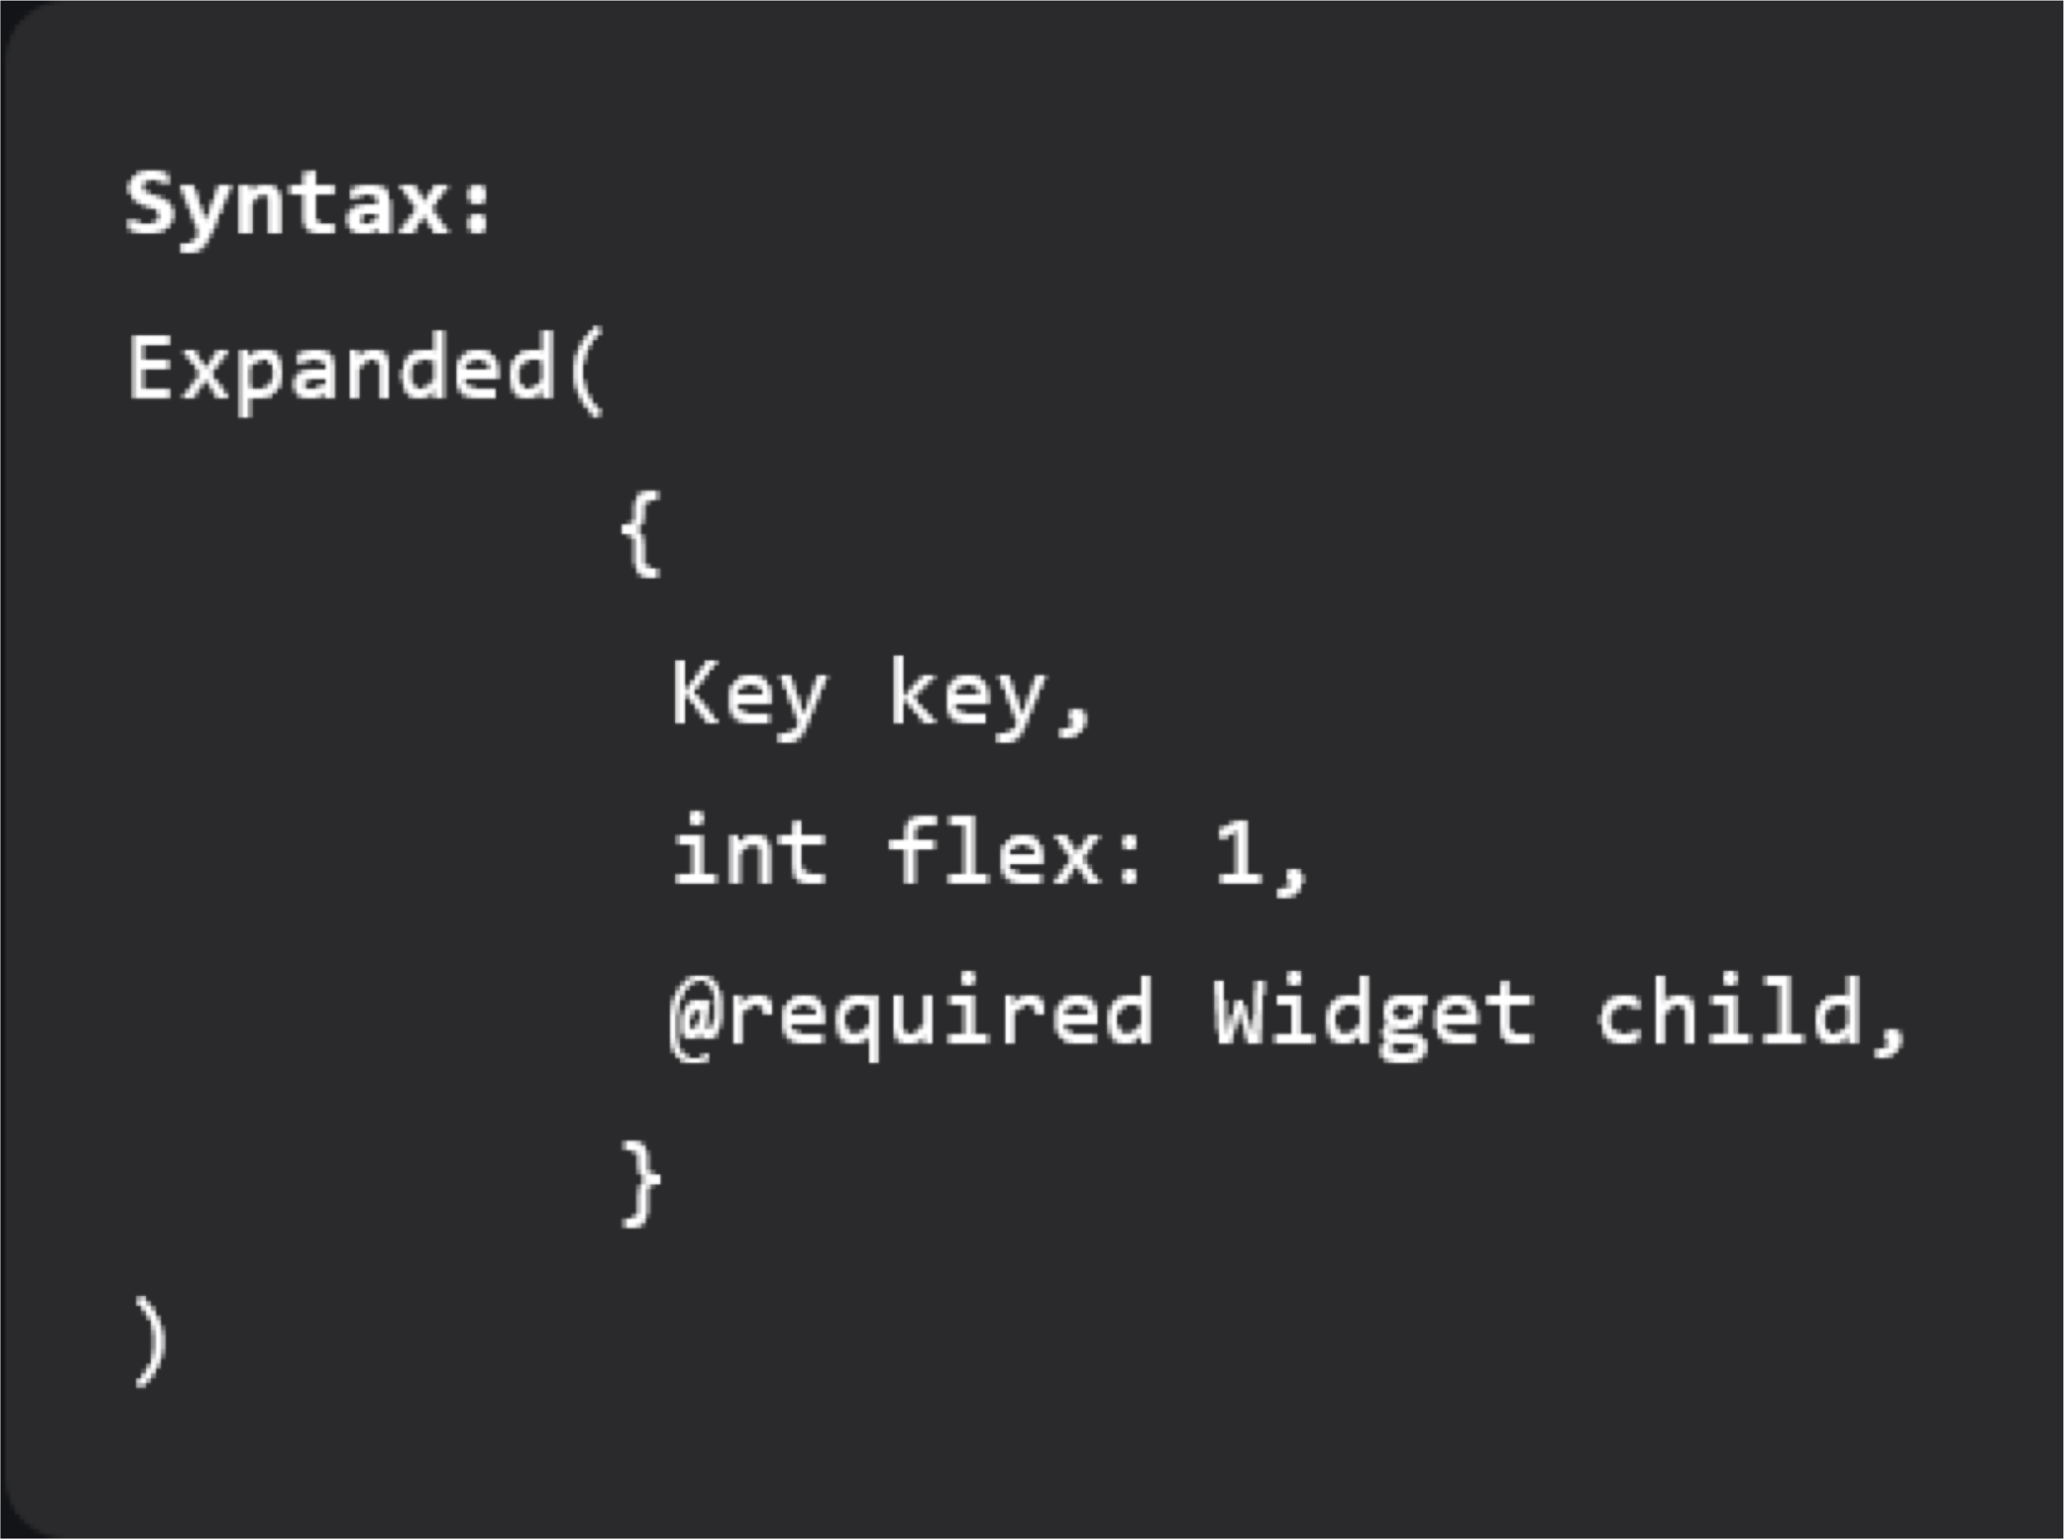
Expanded Class in Flutter
Properties of Expanded Class:
child: This is the widget present below the expanded class
Flex factor: Flex factor is the ratio in which
available space is divided among the children to occupy the main axis. If the flex factor is zero or NULL, the child will allocate its size on its own.
Key: It manages how one widget is replaced by
another widget
FlexFit: It defines how flexible one widget to acquire available space.

Slide 13
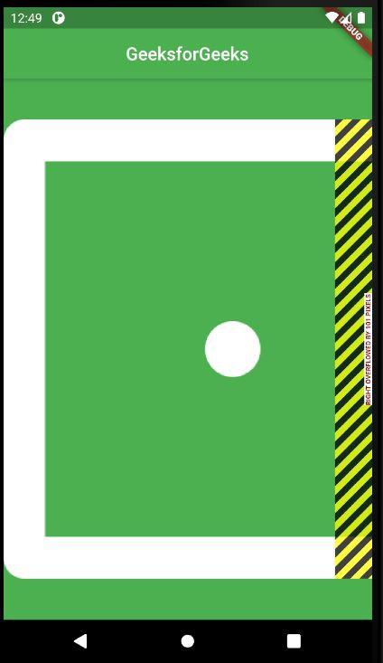
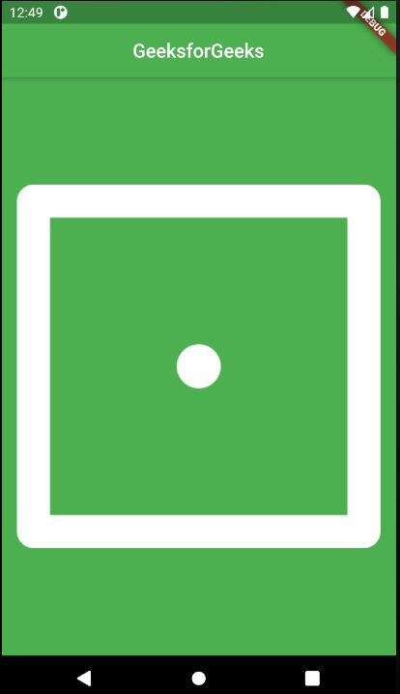
Expanded Class in Flutter

Slide 14
Flutter – Dialogs

Slide 15
Flutter – Dialogs
The dialog is a type of widget which comes on the window or the screen which contains any critical information or can ask for any decision. When a dialog box is popped up all the other functions get disabled until you close the dialog box or provide an answer. We use a dialog box for a different type of condition such as an alert notification, or simple notification in which different options are shown, or we can also make a dialog box that can be used as a tab for showing the dialog box.
Types of dialogs in a flutter
AlertDialog
SimpleDialog
showDialog

Slide 16
AlertDialog
Alert dialog tells the user about any condition that requires any recognition. The alert dialog contains an optional title and an optional list of actions. We have different no of actions as our requirements. Sometimes the content is too large compared to the screen size so for resolving this problem we may have to use the expanded class.

Slide 17
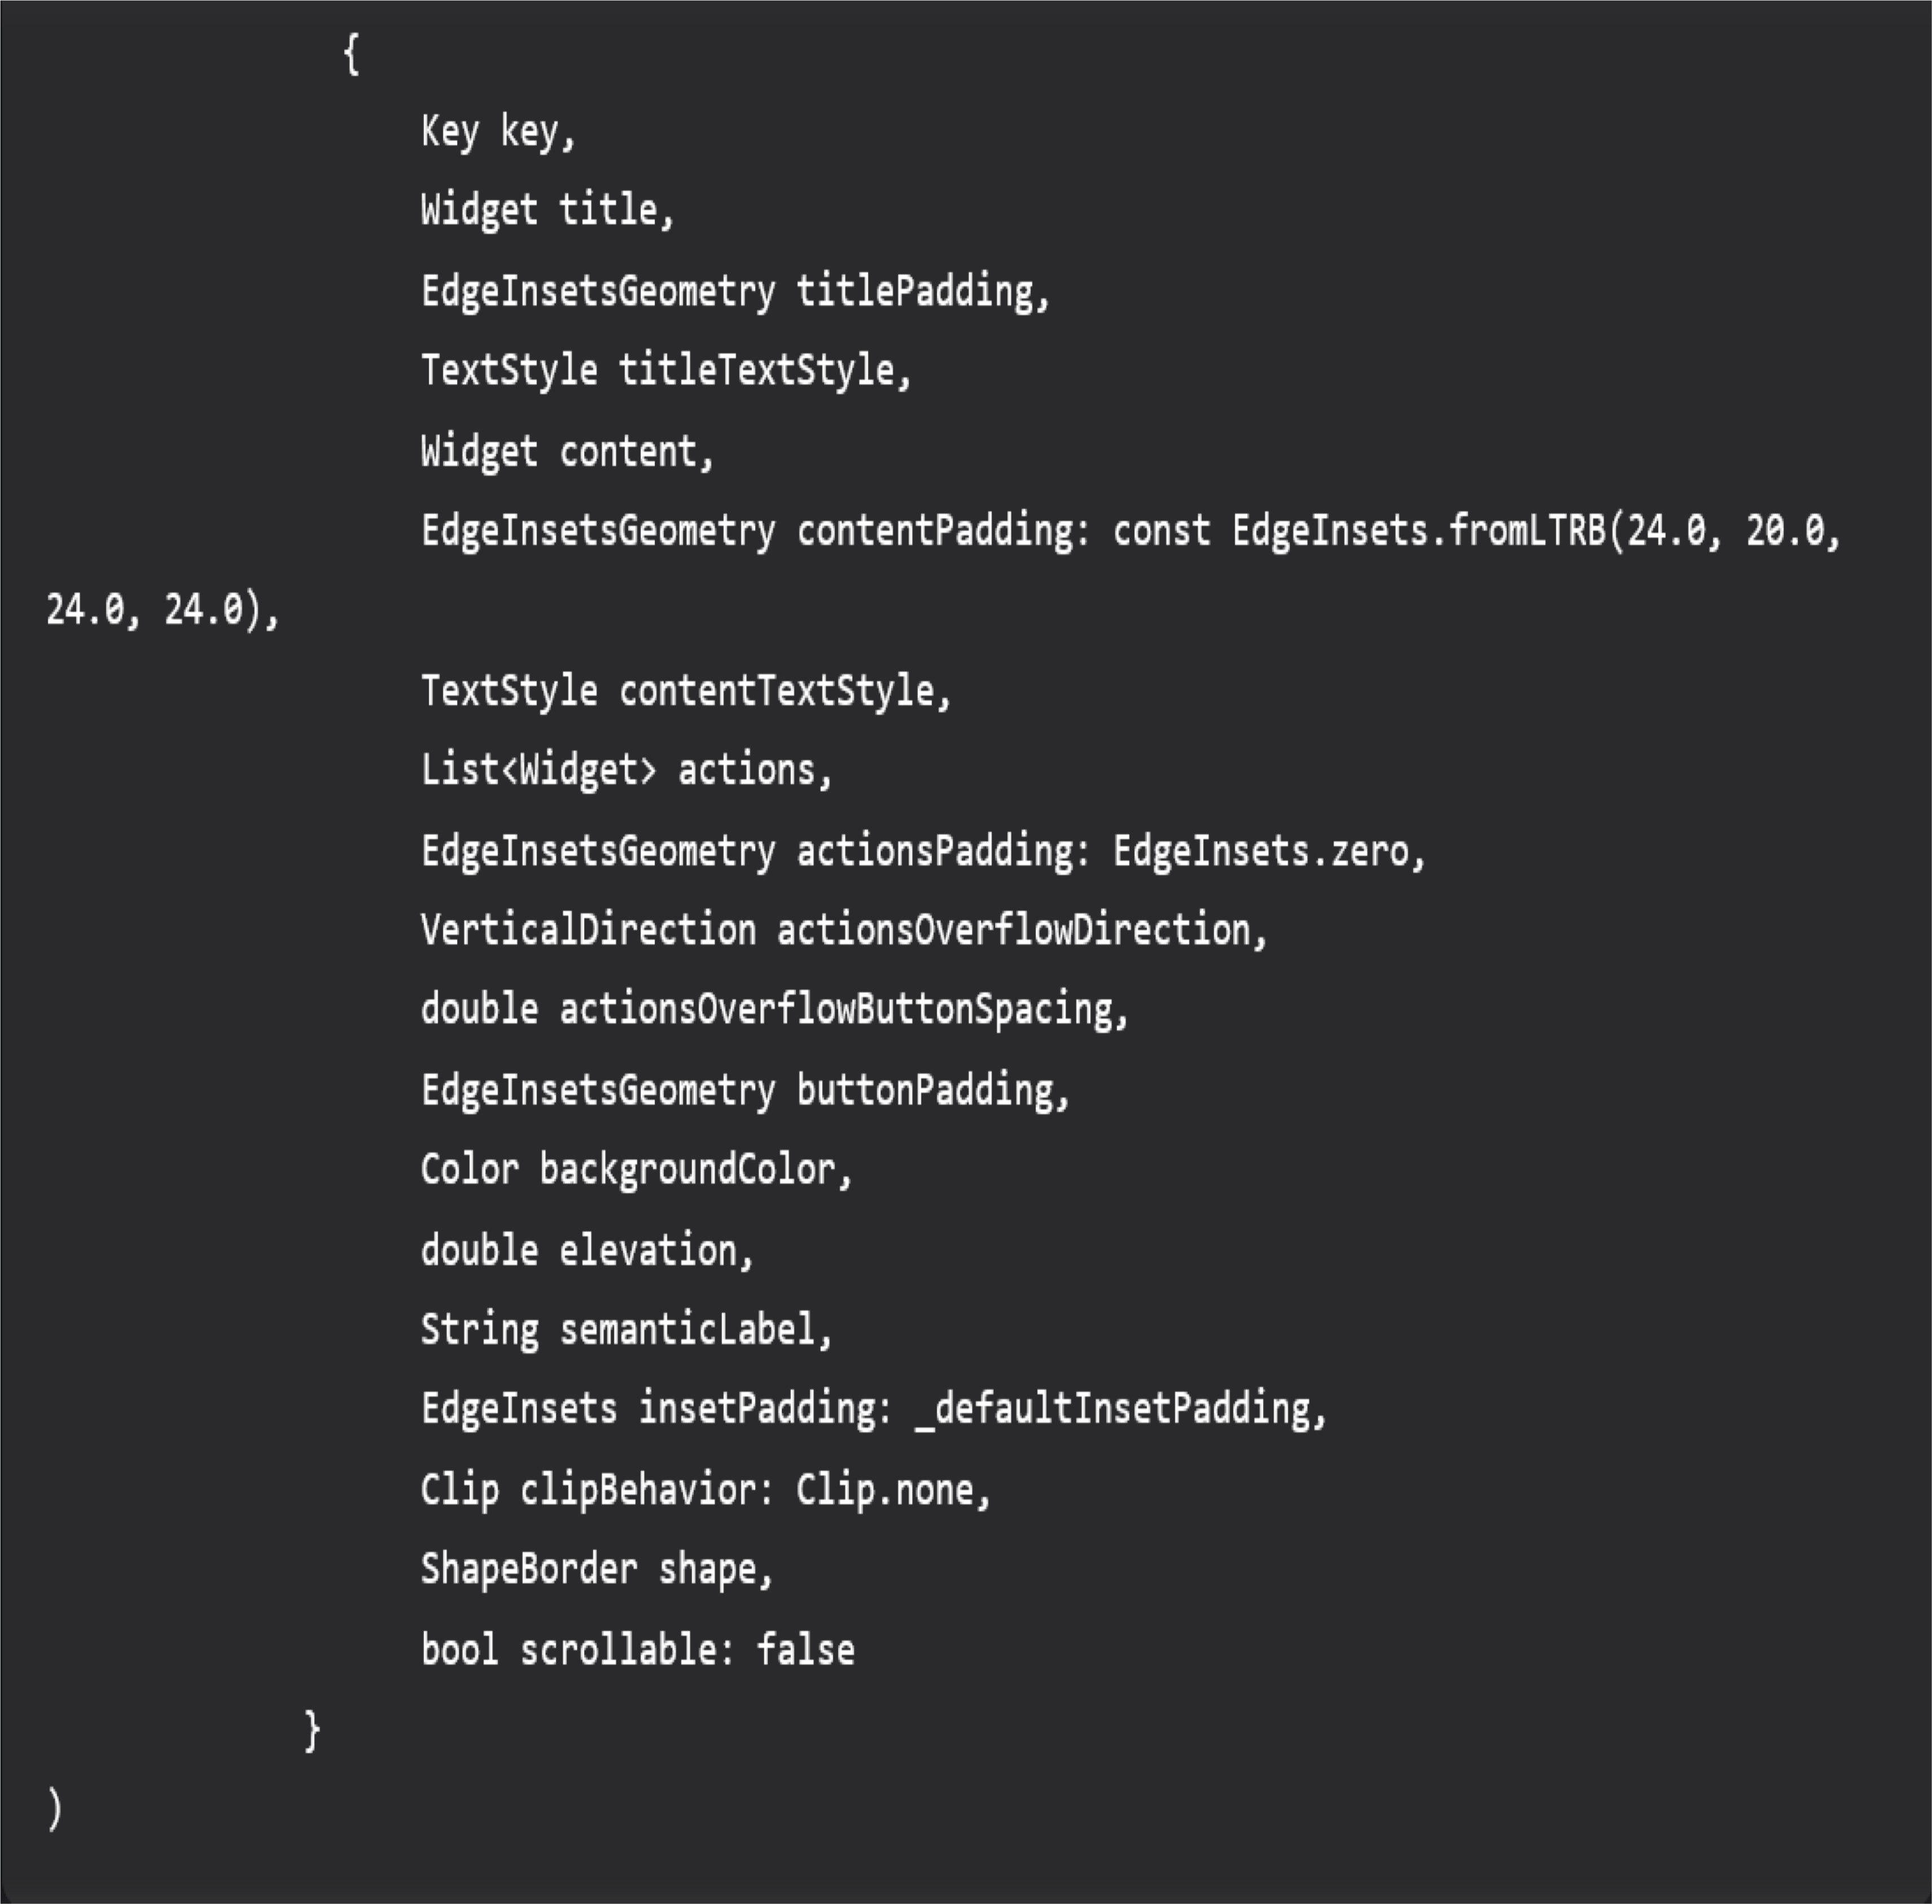
AlertDialog
Properties:
Title: It is always recommended to make our dialog title as short as possible. It will be easily understandable to the user.
Action: It is used to show the content for what action has to perform.
Content: The body of the alertDialog widget is defined by the content.
Shape: It is used to define the shape of our
dialog box whether it is circular, curved, and many more.

Slide 18
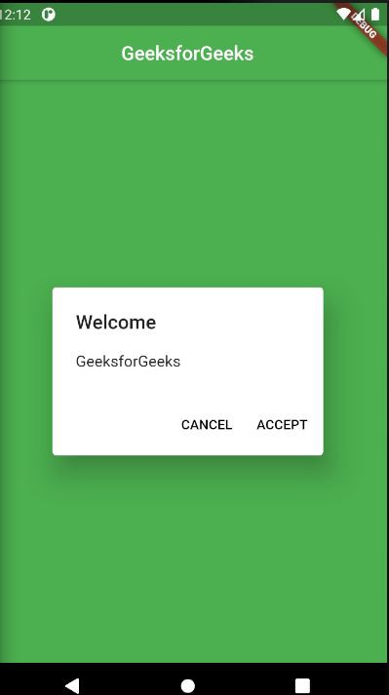
AlertDialog

Slide 19
Simpledialog
A simple dialog allows the user to choose from different choices. It contains the title which is optional and presented above the choices. We can show options by using the padding also. Padding is used to make a widget more flexible.

Slide 20
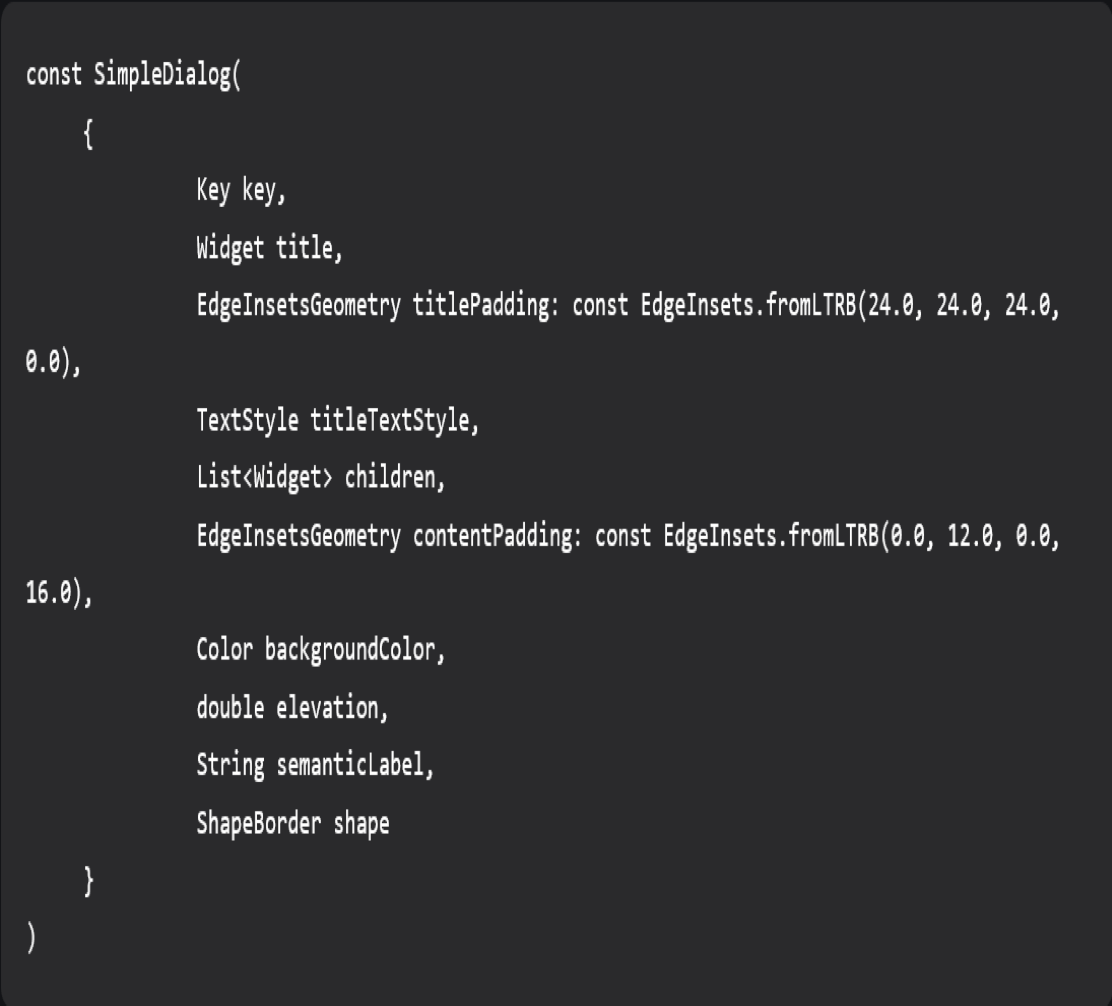
SimpleDialog
Properties:
Title: It is always recommended to make our dialog title as short as possible. It will be easily understandable to the user.
Shape: It is used to define the shape of our dialog box whether it is circular, curve, and many more.
backgroundcolor: It is used to set the background color of our dialog box.
TextStyle: It is used to change the style of our text.

Slide 21
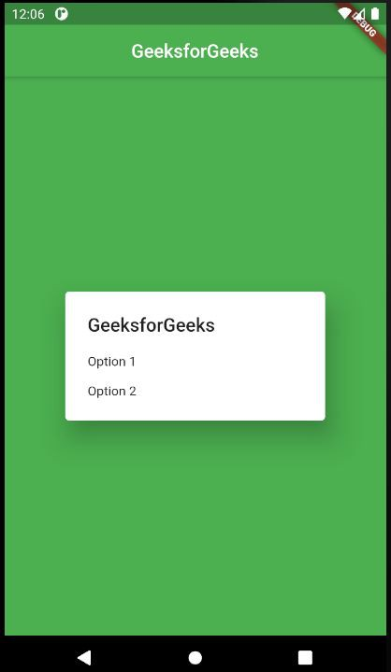
SimpleDialog

Slide 22
Show Dialog
It basically used to change the current screen of our app to show the dialog popup. You must call before the dialog popup. It exits the current animation and presents a new screen animation. We use this dialog box when we want to show a tab that will popup any type of dialog box, or we create a front tab to show the background process.

Slide 23
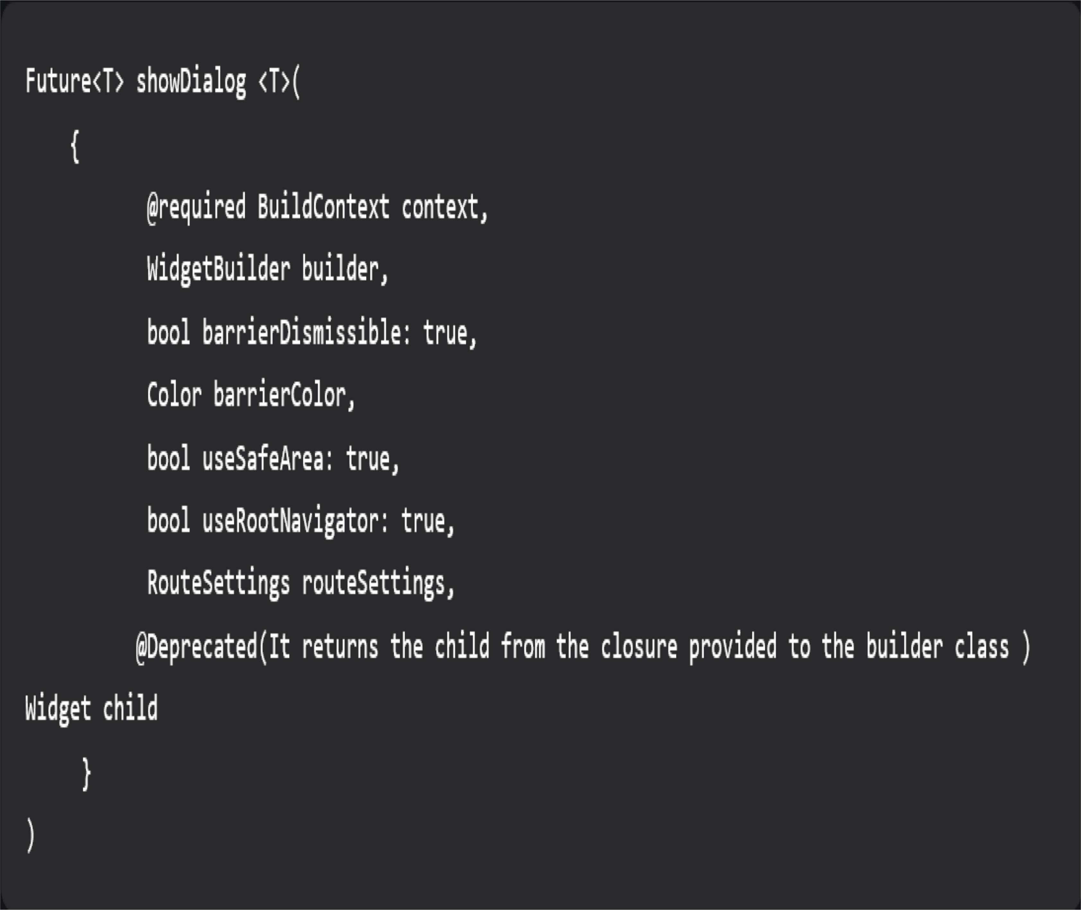
Show Dialog
Properties:
Builder: It returns the child instead of creating a child argument.
Barriercolor: It defines the modal barrier color which darkens everything in the dialog.
useSafeArea: It makes sure that the dialog
uses the safe area of the screen only not overlapping the screen area.

Slide 24
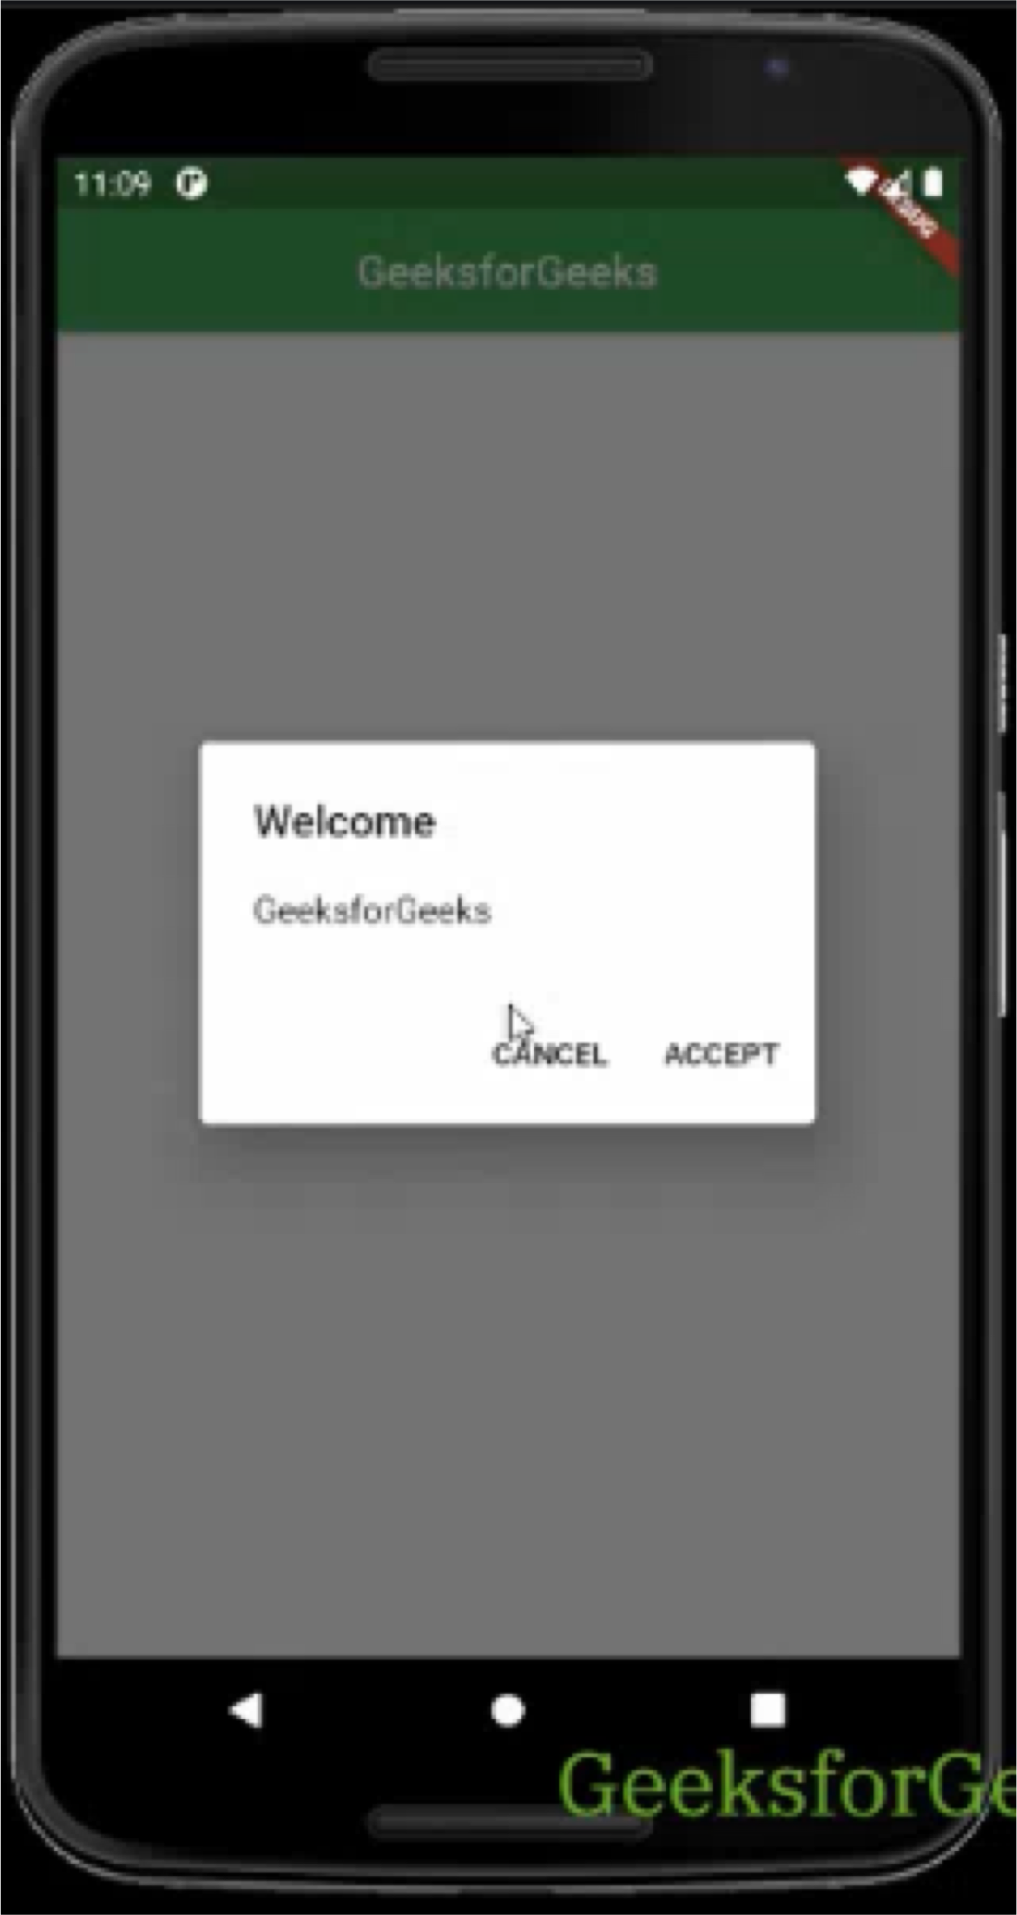
Show Dialog

Slide 25
Key Difference
AlertDialog
Used to show any type of alert notification.
We can give the option to react to the alert popup like the accept button or reject button.
SimpleDialog
Used to show simple options as a dialog box.
There are different options to choose from and perform functions according to them. The option can be simple like choosing between different emails.
ShowDialog
Used to create an option that will popup a dialog box.
By using this we can popup different types of dialog boxes like alertDialog, and SimpleDialog as a sub widget.

Slide 26
Flutter – Circular & Linear Progress Indicators

Slide 27
Flutter – Circular & Linear Progress Indicators
Progress Indicator in any application displays the time which is needed for some tasks to complete such as downloading, installation, uploading, file transfer, etc. This shows the progress of a task or the time to display the length of the processes.
In Flutter, progress can be displayed in two ways:
Circular Progress Indicator: A Circular Progress Indicator is a widget that shows progress along a circle. It is a circular progress bar that spins to indicate that the application is busy or on hold.
Linear Progress Indicator: A Linear Progress Indicator also known as a progress bar is a widget
That shows progress in a linear direction or along a line to indicate that the application is in progress.

Slide 28
Flutter – Circular & Linear Progress Indicators
There are two types of progress indicators:
Indeterminate: Indeterminate progress indicator is an indicator that does not display a specific value at any instance of time and only indicates that progress is being made. It does not indicate how much progress remains to be made. For creating an indeterminate progress bar we set the value property as null.
Determinate: Determinate progress indicator is an indicator that has a specific value at each
instance of time. It also indicates how much progress is completed. The value in the determinate progress indicator increases monotonically from 0 to 1, where 0 indicates that progress is just started and 1 indicates that the progress is completed.

Slide 29
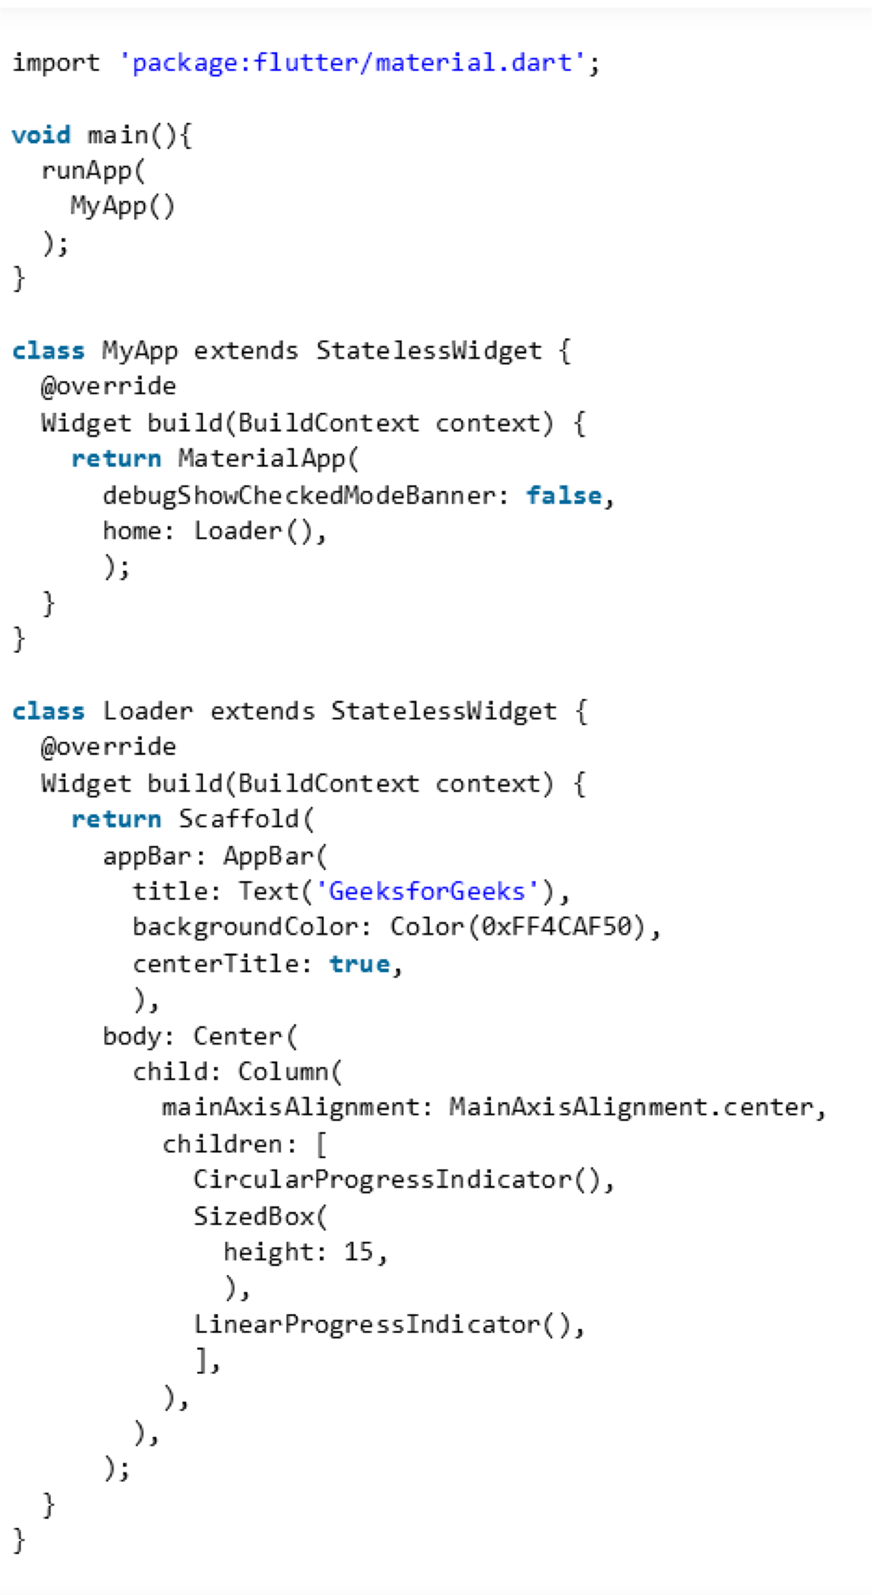
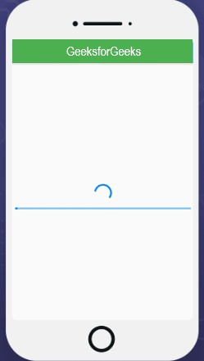
Flutter – Circular & Linear Progress Indicators

Slide 30
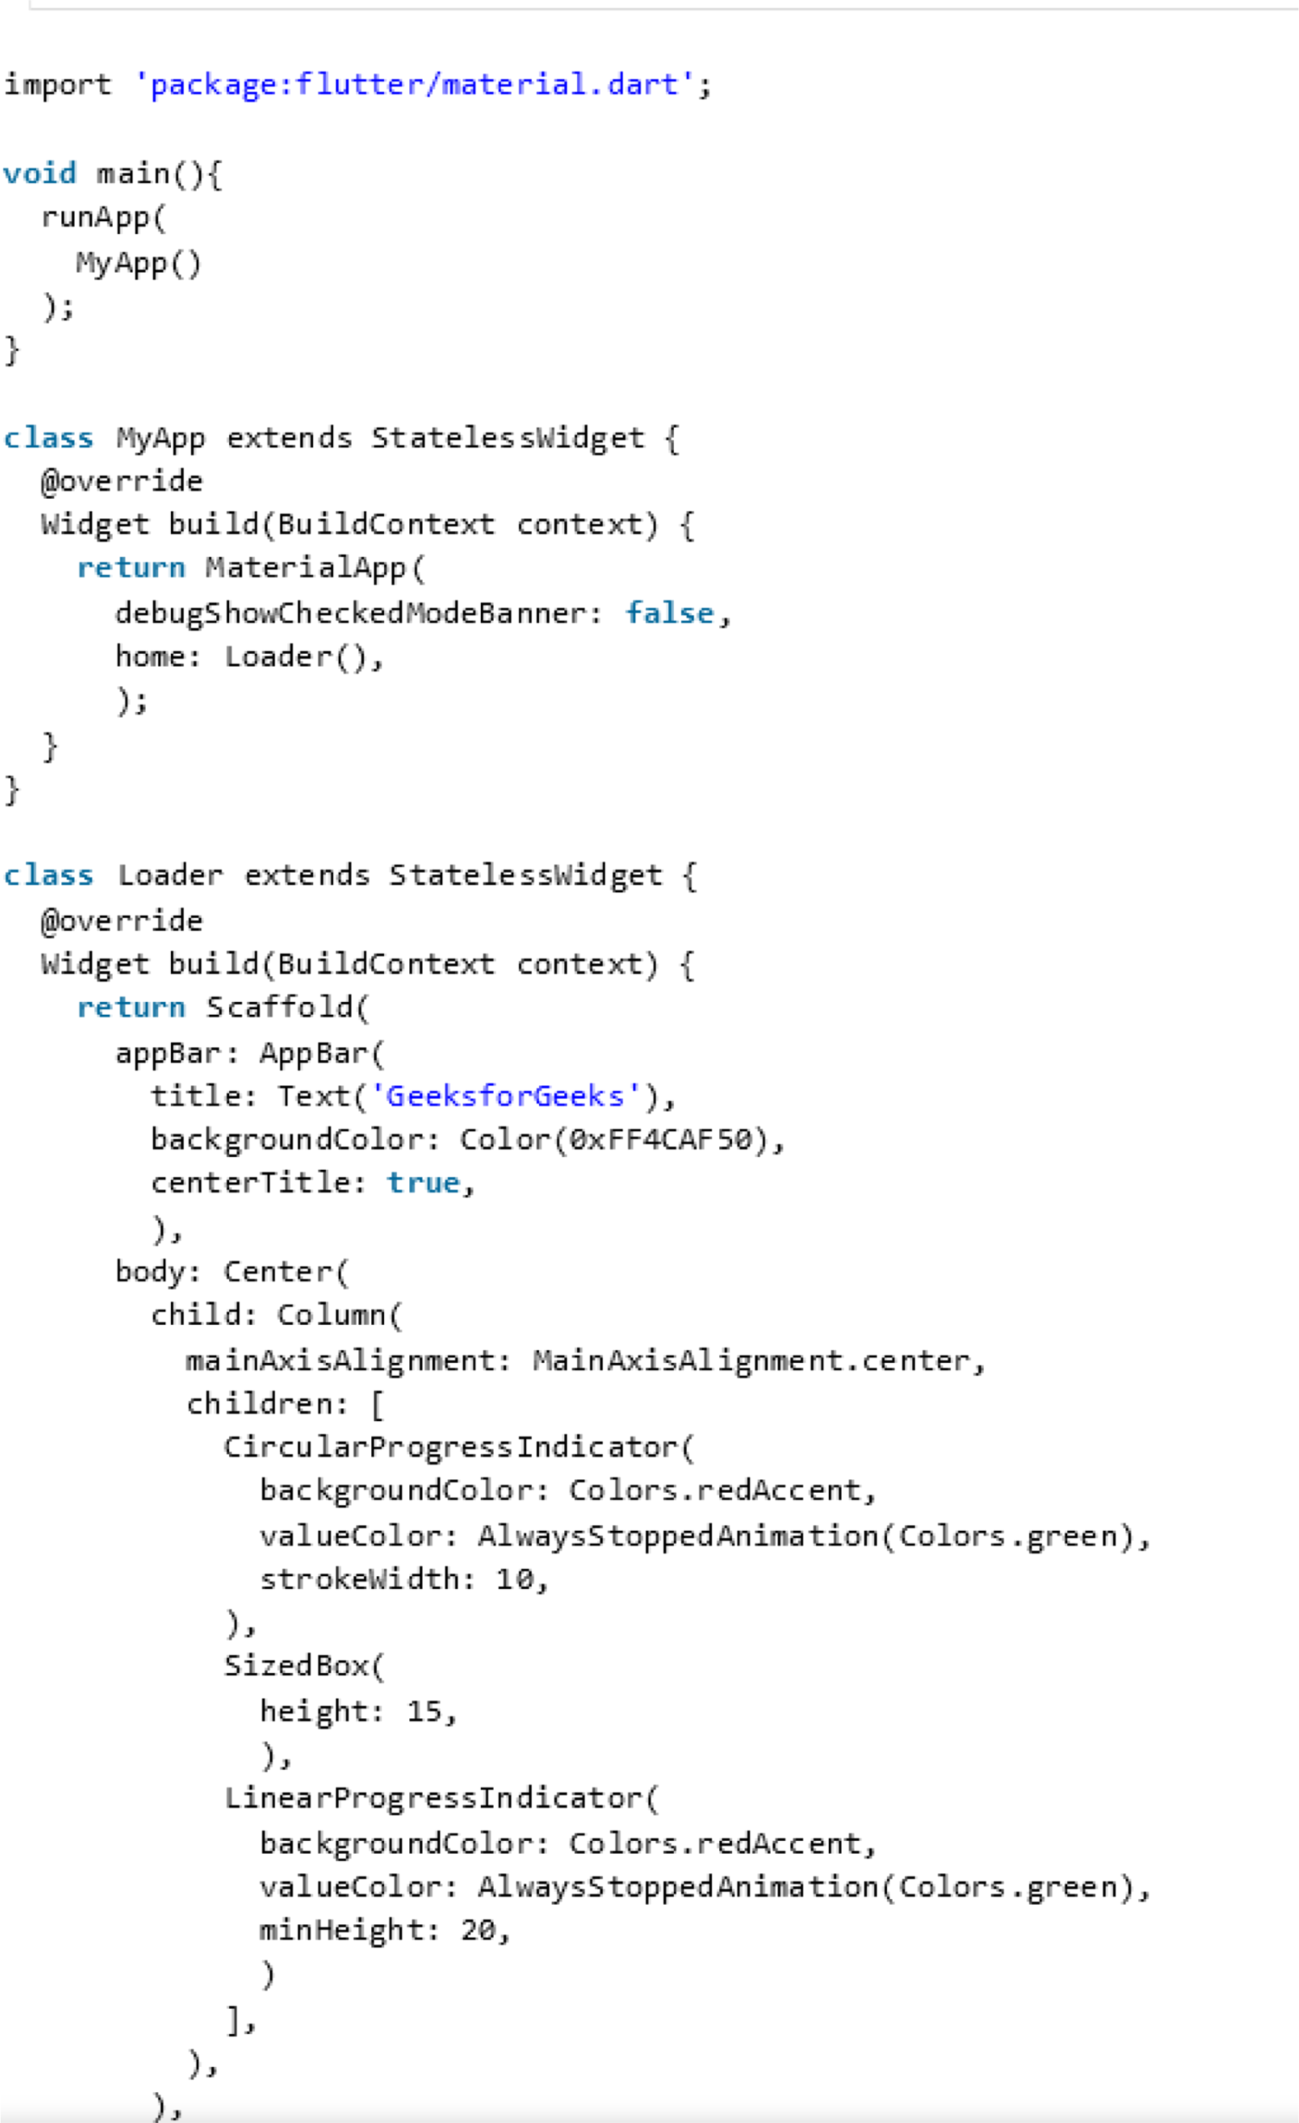
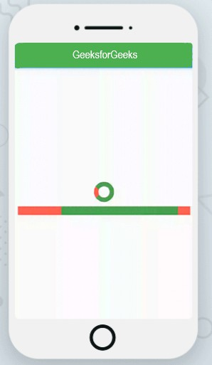
Flutter – Circular & Linear Progress Indicators

Slide 31
Flutter – Circular & Linear Progress Indicators
Explanation:
Following is the explanation of above-mentioned code for implementing Progress Indicators in Flutter:
backgroundColor: This property is used in order to set the background color of a linear loader and a circular spin loader in the progress bar.
strokeWidth: This property specifies the width of the line that is used to draw a circle in a
CircularProgressIndicator.
minHeight: It is the minimum height of the line that is used to draw the indicator in a
LinearProgressIndicator or in other words it is used to define how thick the line in an indicator looks.
valueColor: It is used in order to define the progress indicator’s value as an animated value. valueColor
property covers the highlights of the completed task valued.
AlwaysStoppedAnimation: It is used in order to specify a constant color in the valueColor property.
value: Value property is used in order to differentiate between the determinate and indeterminate progress bar. If the value property is set as null, the progress indicator is indeterminate, which means that it will show the predefined animation on the indicator with its motion that does not indicate how much progress is completed. If set as non-null, then it displays how much progress is being made at a particular instant. A value of 0.0 indicates that progress is just started and a value of 1.0 indicates that the progress is completed.

